Slide 1
Writing Effective Tests
Iain Brighton – Virtual Engine

Slide 2
Agenda
Unit and Integration tests
Unreliable tests and causes
Where to start testing
Testing methodologies
Wrap up and tips

Slide 3
Test What?
Unit Tests
Fast and repeatable
Full control/isolation of the test
Anyone should be able to run them easily
Integration (Functional) Tests
Hard(er) and Slow(er)
Typically require lots of configuration/setup
Use one or more real dependencies
File system or the system’s date/time
Notes:
Break down the functionality of your program into discrete testable behaviours that you can test as individual “units”

Slide 4
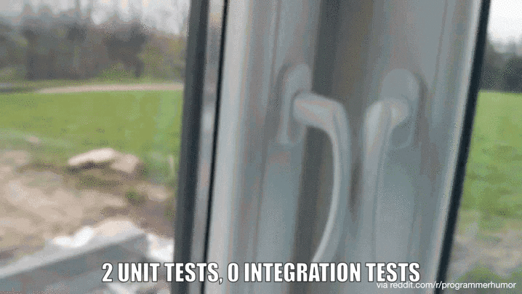
Integration Tests

Slide 5
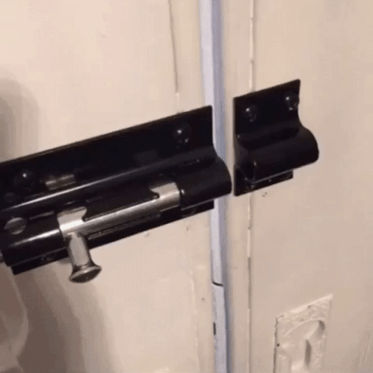
Integration Tests

Slide 6
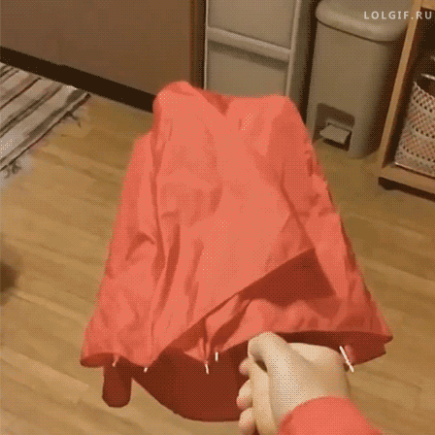
Integration Tests

Slide 7
Testing Terminology
System Under Test (SUT)
Fakes
Contain fixed data and no logic
Simply returns good/bad data
Stubs *
Return consistent fake implementations
Solely used to isolate dependencies
Mocks
Used to verify expected internal behaviour of the SUT
Notes:
Pester uses the Mock keyword for both stubs and mocks
Mocks contain an Assert to verify correct external interaction/behaviour

Slide 8
Test What?
Unit Tests
Fast and repeatable
Full control/isolation of the test
Anyone should be able to run them easily
Integration (Functional) Tests
Hard(er) and Slow(er)
Typically require lots of configuration/setup
Use one or more real dependencies
File system or the system’s date/time

Slide 9
(Overly) Brittle Tests
Hard to maintain
Unreliable or random failures
Over specification
Test “Smells”
Constrained test order
Shared state corruption
Difficult to name due to doing to much
Notes:
All tests should be brittle or they’re not testing the right things!
We can’t help new functionality/implementations ☹
Over specification
Every change breaks tests
Testing the internal implementation/behaviour rather than just the expected end result
Testing too much, e.g. using multiple mocks (Assert-MockCalled)
Constrained test order
Can’t run a subset of the tests
Running a subset provides different results
Shared State Corruption
Tests not initialising its own state or cleaning up correctly
Also true in integration testing with file systems/databases

Slide 10
Testing Nirvana
Test public interface (the Contract)
If public methods can exercise all internal code paths - consider it tested
You don’t have redundant code anyway, right?!
Consider integration tests to avoid endless stubbing

Slide 11
function SUT {
param (
[Int] $InputA,
[Int] $InputB,
[Switch] $InverseOutput
)
if ($InverseOutput)
{
$result = Get-SUTOutput -A $InputA -B $InputB
}
else
{
$result = Get-SUTOutput -A $InputB -B $InputA
}
return $result
}

Slide 12
Test Organisation
In source control
Alongside the code it’s testing
Test structure is important
Segregate Unit and Integration tests
Typically by execution speed
Make Unit tests super-easy to run
Include all dependencies
Notes:
Use a test/task runner wherever possible
OVF does a similar thing with Simple and Complex tests

Slide 13
Test Naming
You should not have to read the test implementation to understand:
What is being tested
Under which condition(s)
What he expected outcome is
Describe blocks should contain the SUT, e.g. function name
It blocks should contain the scenario under test and the expected output
Notes:
Create tests from DSC configuration document
.psd1 file required for Lability to function anyway

Slide 14
Test Arrangement
Arrange
Prepare prerequisites and setup test objects
Act
Perform the unit of work under test
Assert
Verify the result
One assertion per test *
Notes:
Testing the same object state is different to testing multiple concerns
Difficult to know which assertion failed
For properties use either test cases or test object equivalence
Best when it’s easy to create an object with ALL the required properties and you know the value of ALL expected properties

Slide 15
Test Readability
Test code should have the same amount of care as production code
Consider the reader
Be more verbose
D(o)RY (not DRY)

Slide 16
Test Duplication
Use Test Cases to remove code duplication
Create an internal testing framework with common testing functions
Try and avoid test setup << SUBJECTIVE!
Reduces readability
Refactor into a helper method
Manually call this in each test arrangement
The developer then has visibility that something is called
Notes:
AfterEach and AfterAll are less problematic

Slide 17
Test Reinforcement
Use Try/Catch
Test the Exception message
Make sure expected exception is thrown!
Every test is an implicit “Should Not Throw”
No need to define a test
Notes:
Most frameworks (inc Pester) will report a failure on any unexpected exception

Slide 18
Test Stubs
When dependencies aren’t available, stubs should be defined with the correct signature
For example, Get-ADUser should have the same signature as the official cmdlet
Otherwise, unit tests may pass but fail in production
Still better to catch in integration tests than production though ;)
Notes:
Indented.StubCommand module by Chris Dent
http://theshellnut.com/storing-mock-objects-in-json-file/

Slide 19
Code Coverage
Start small
Increment coverage with each commit
Focus on the most problematic code
If it’s painful – do it more often – until it hurts less/no more*
Targeting 100% coverage will lead to madness

Slide 20
Testing Tips
Test only the public interface/contract (where possible)
Test one concern per test (one Mock/Assert per test)
Avoid logic in tests (where possible)
Now you may have 2 problems!

Slide 21
Pester Tips
-InModuleScope
Should be a test “smell”
Could you make it public?
Use Mock and Assert-Mock –ModuleName instead
-ParameterFilter not required on Mock
Can still Assert-MockCalled with –ParameterFilter
Always be testing Exception messages

Slide 22
Pester Tips
Use “Guard” mocks
Parameter-less catch all for destructive actions
Use cmdlets instead of direct .NET calls
If needed factor them out into a function to enable testing
You can stub calls to executables

Slide 23
Resources
ReportUnit - http://reportunit.relevantcodes.com/
Format-Pester - https://github.com/equelin/Format-Pester
Stubbing Commands - https://github.com/indented-automation/Indented.StubCommand
PowerShell v5 only
Storing Complex Fakes - http://theshellnut.com/storing-mock-objects-in-json-file/

Slide 24
Resources
Pester Mocks
http://virtualengine.co.uk/2015/mocking-missing-cmdlet-erroraction-with-pester/
http://virtualengine.co.uk/2015/mocking-missing-cmdlet-pipelines-with-pester/

Slide 25
Summary
Start with only the public contract
Don‘t test (or fake) too much
Readability is key
Don‘t fixate on code coverage

Slide 26
Next Steps...
Now: 15 min break
Grab a coffee
Stay here to enjoy next presentation
Change track and switch to another room
Ask me questions or meet me in a breakout session room afterwards

Slide 27
Questions?

Slide 28
About_Author
Principal Consultant @ Virtual Engine
iainbrighton@hotmail.com
github.com/iainbrighton
@iainbrighton
Open Source Projects
Lability – a Hyper-V lab framework
PScribo – a PowerShell documentation DSL
Community DSC resource contributor
Citrix XenDesktop 7.x and NetScaler
Notes:
Lability – https://github.com/VirtualEngine/Lability
PScribo – https://github.com/iainbrighton/Pscribo
Citrix XenDesktop 7.x – https://github.com/VirtualEngine/XenDesktop7

